Slide 1
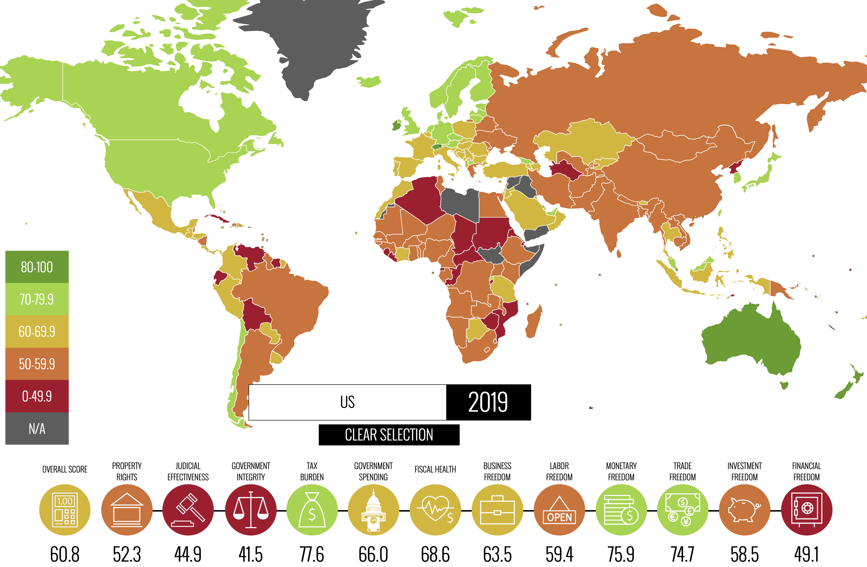
2019 Index of Economic Freedom
“Index of Economic Freedom has measured the impact of liberty and free markets around the globe, and the 2019 Index confirms the formidable positive relationship between economic freedom and progress.”
heritage.org/index
kaggle.com/lewisduncan93/the-economic-freedom-index

Slide 2





Motivation

Slide 3
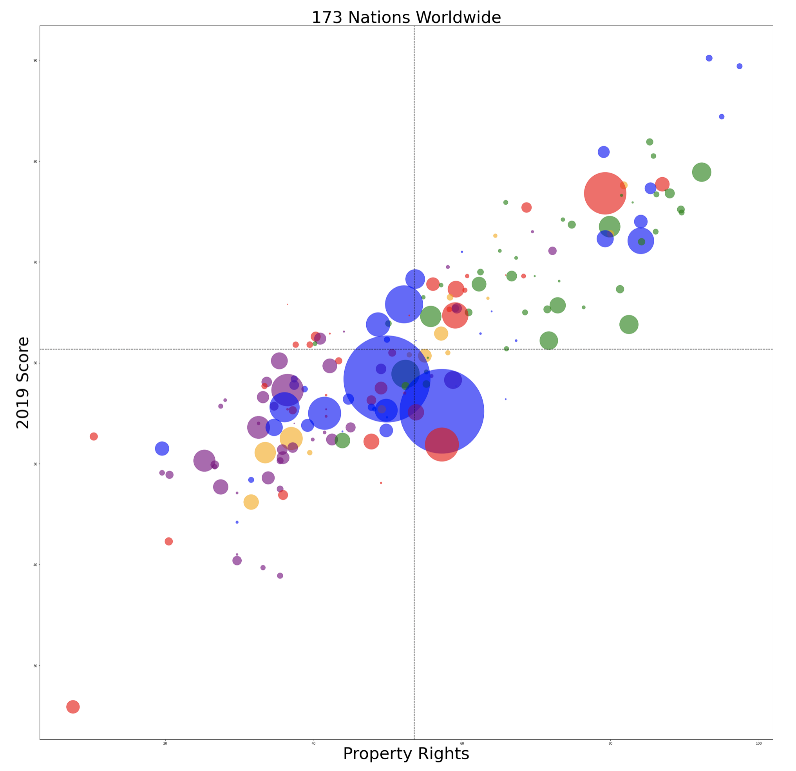
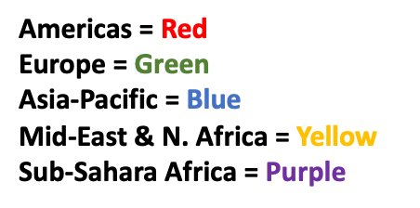
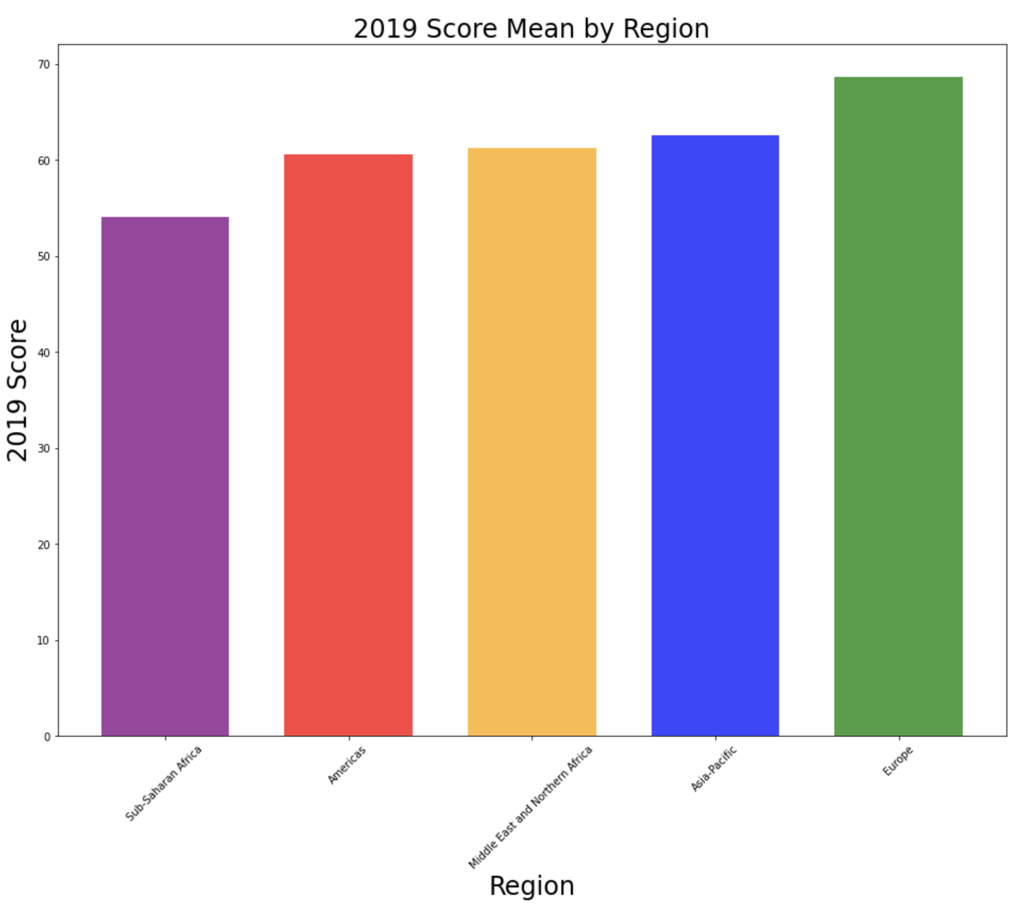

Worldwide Scatter and Bar Chart

Slide 4
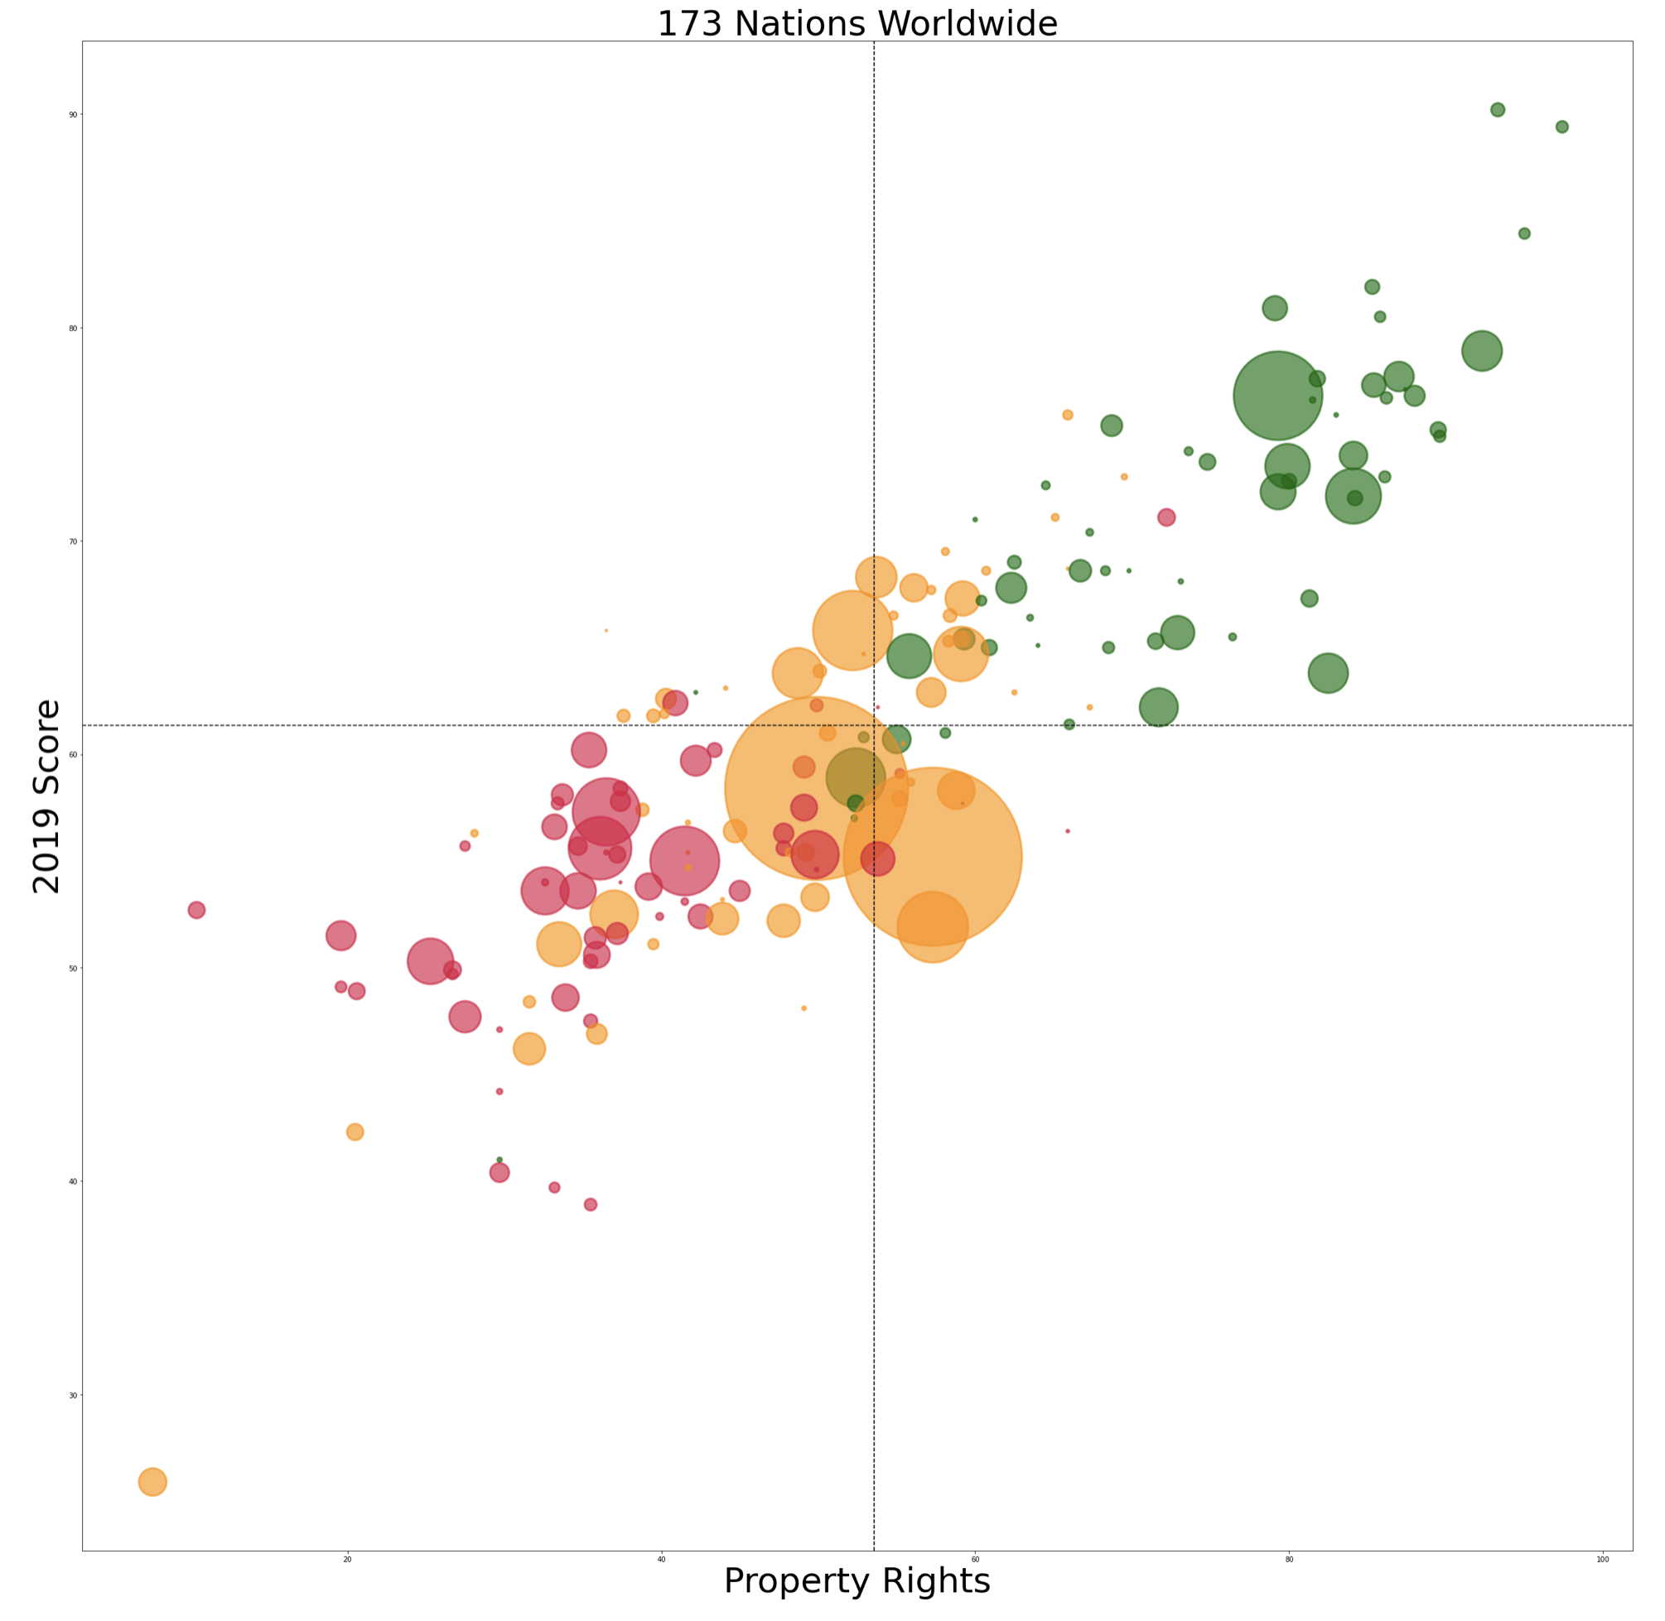
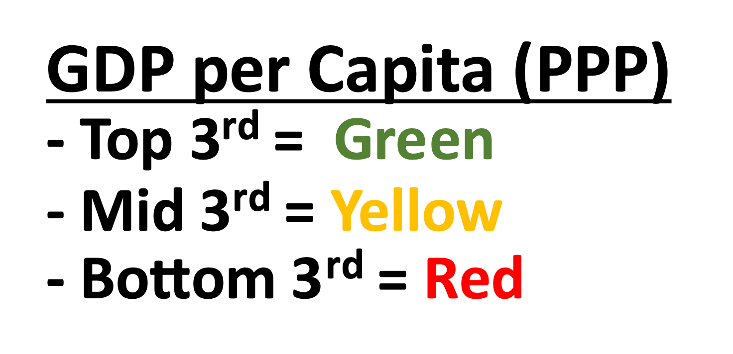
5 Key Variables that Correlate to the 2019 Score
88% - Property Rights
82% - Government Integrity
81% - Judicial Effectiveness
78% - Business Freedom
65% - GDP per Capita (PPP)

Slide 5
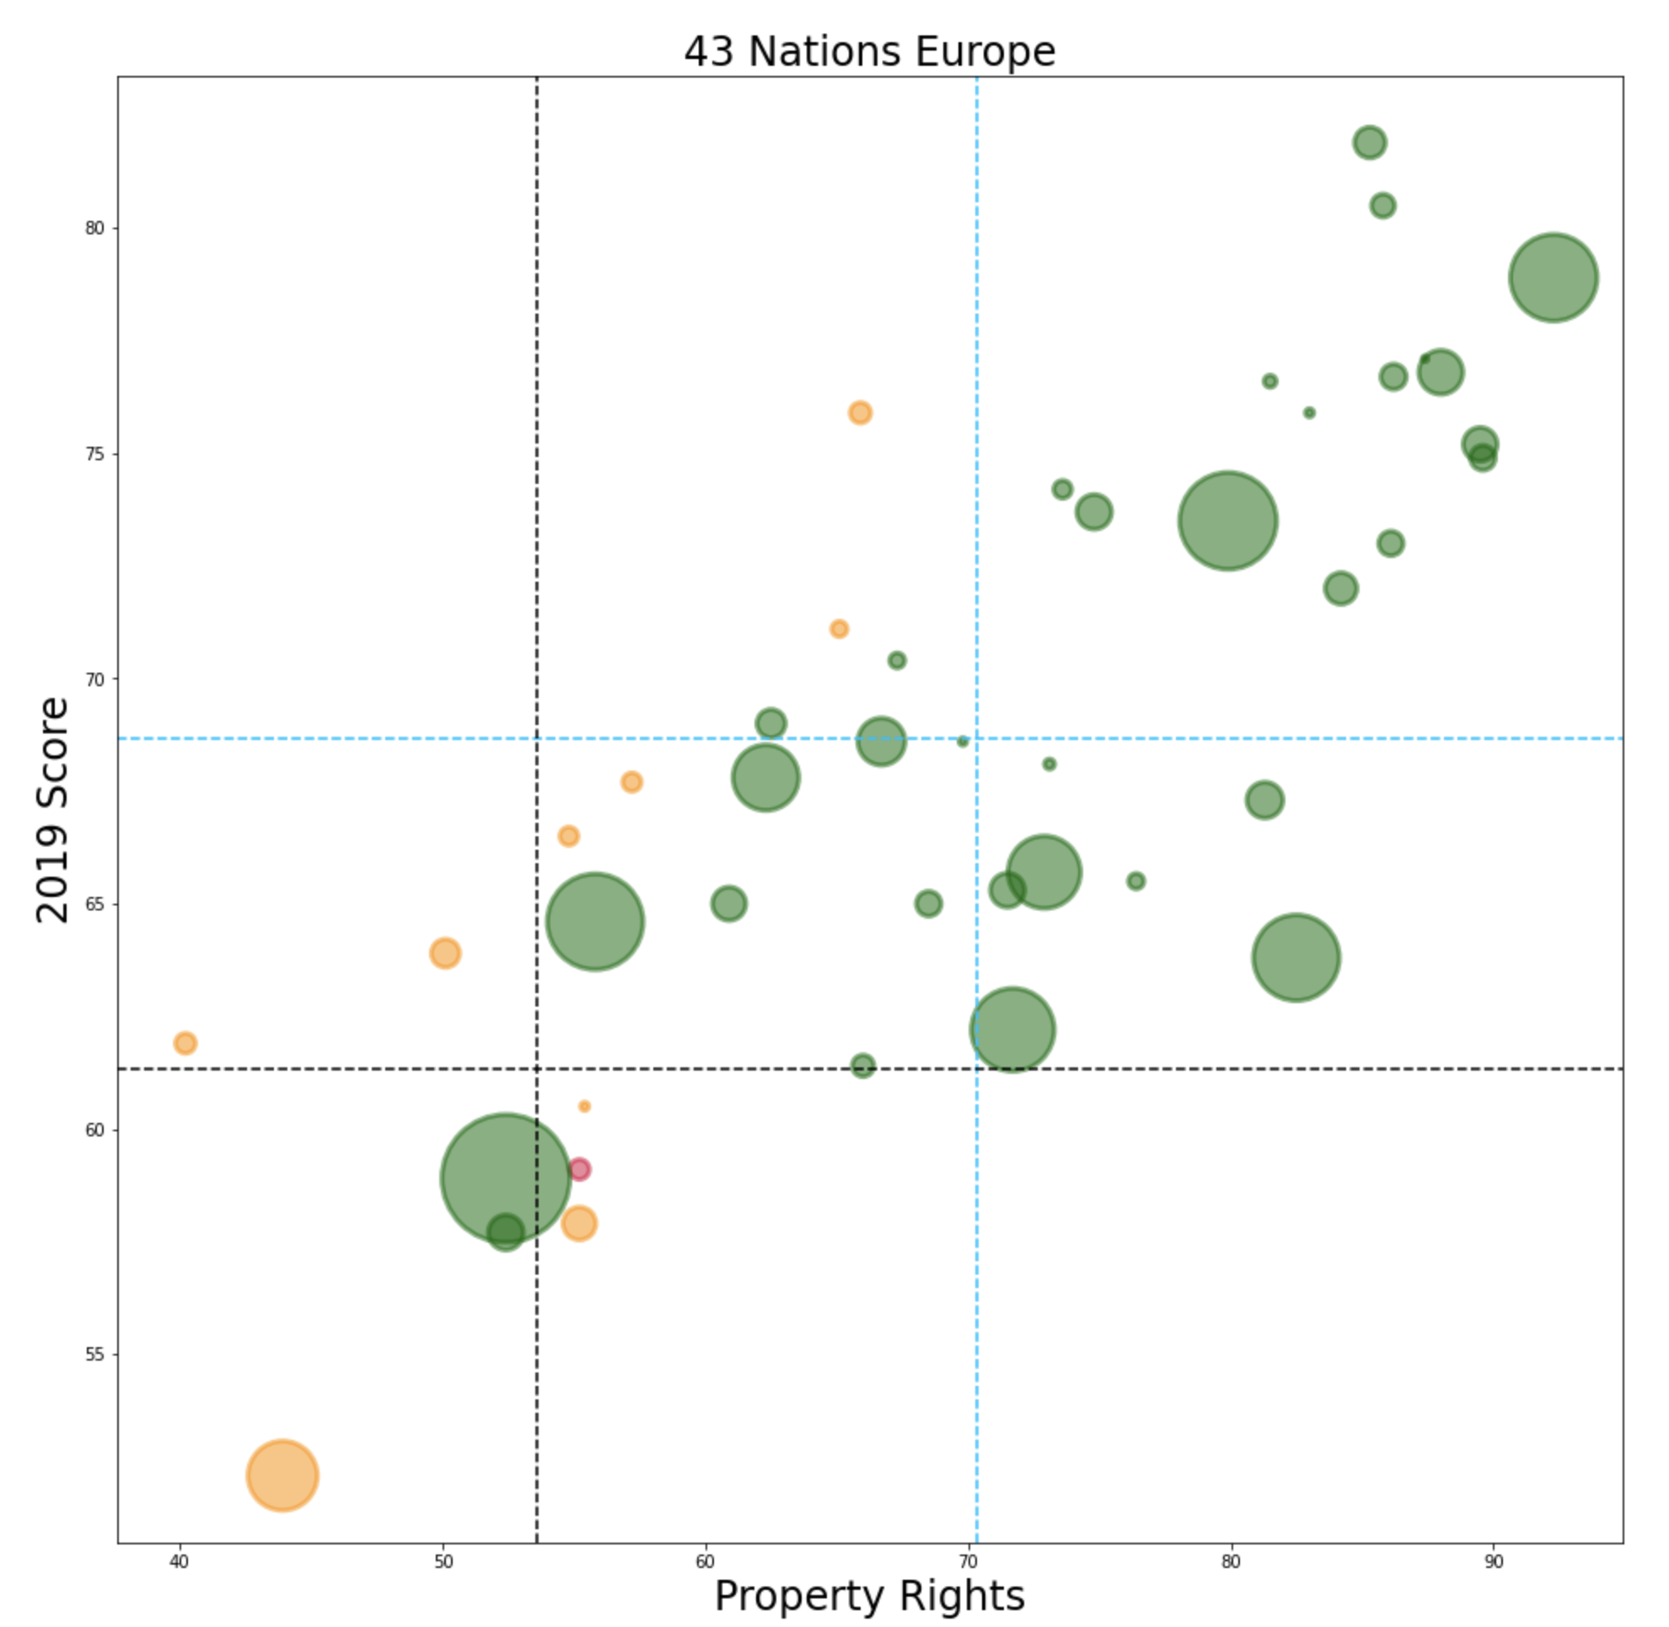
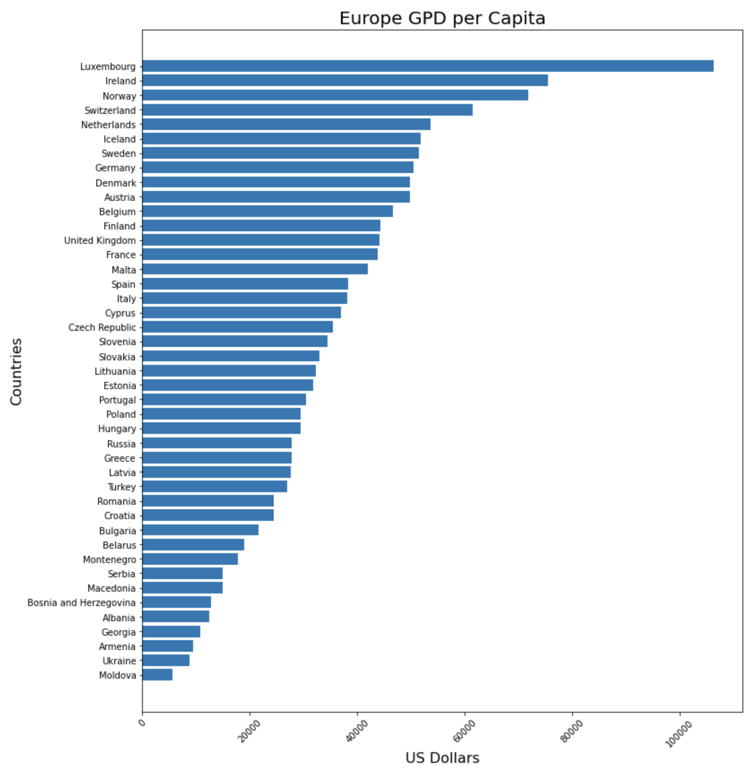
Europe

Slide 6
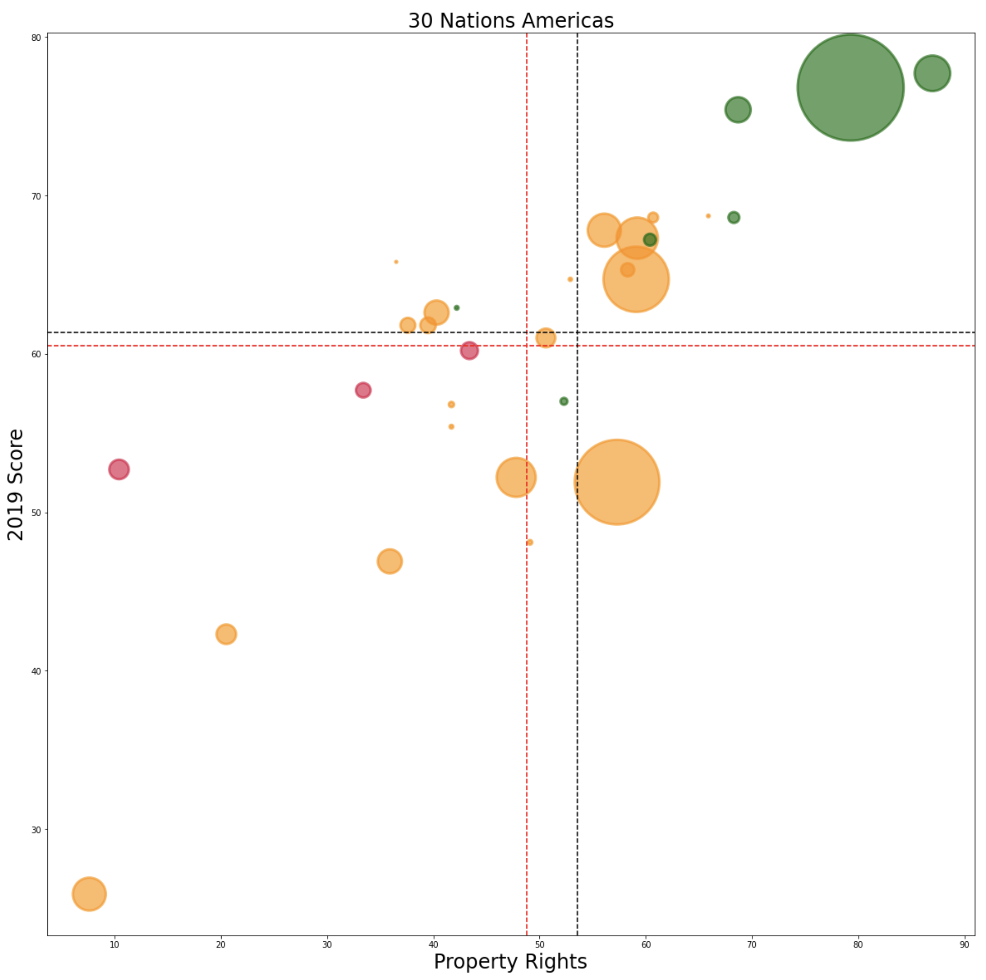
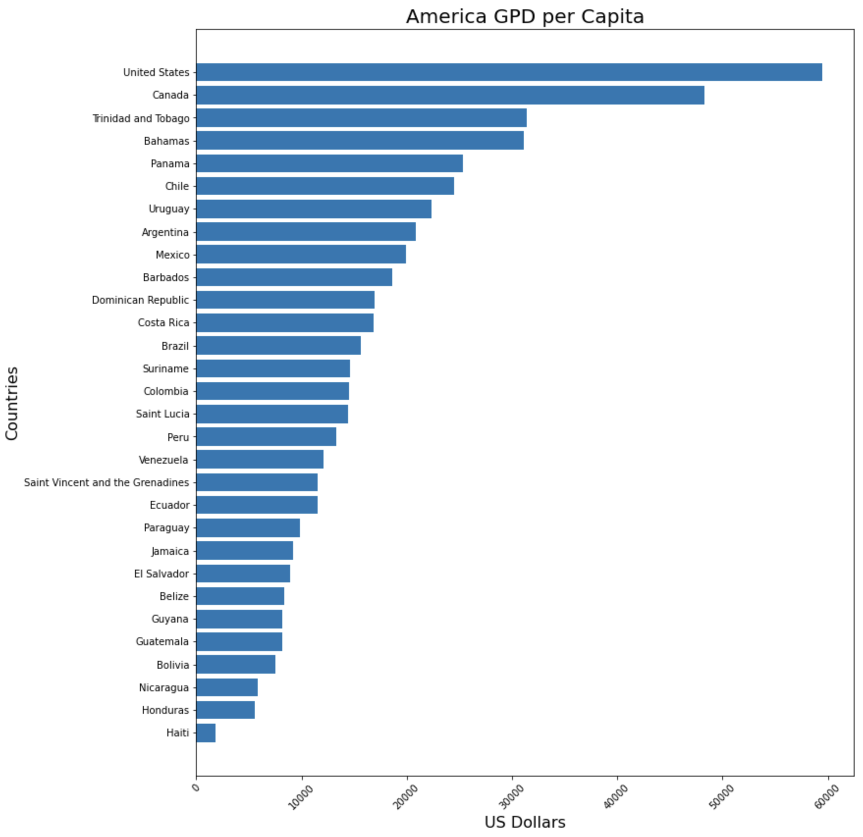
Americas

Slide 7
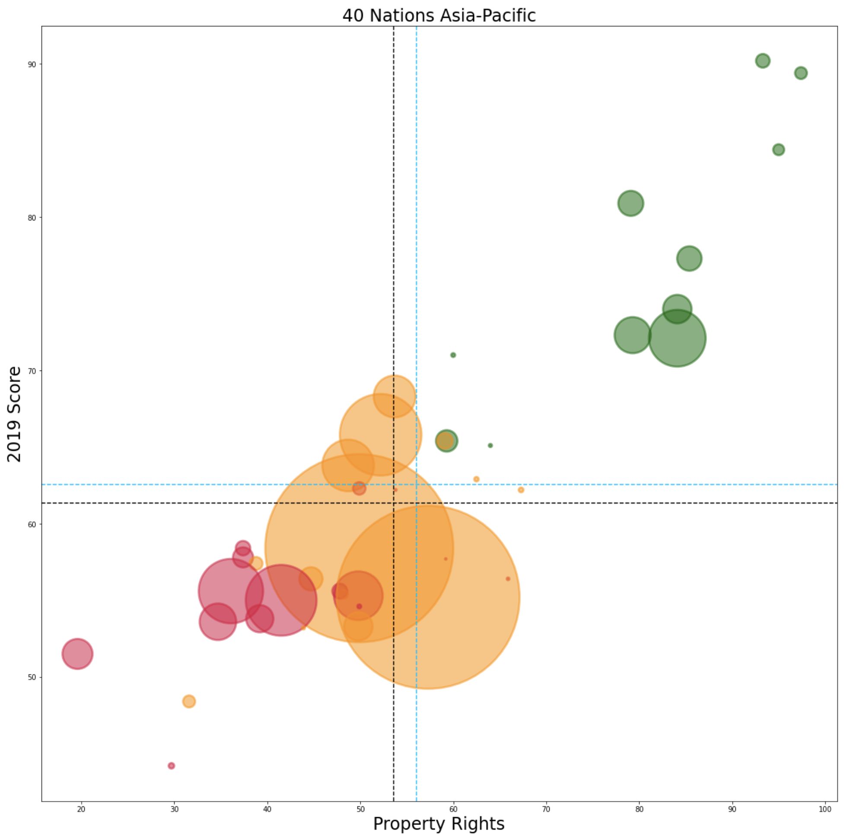
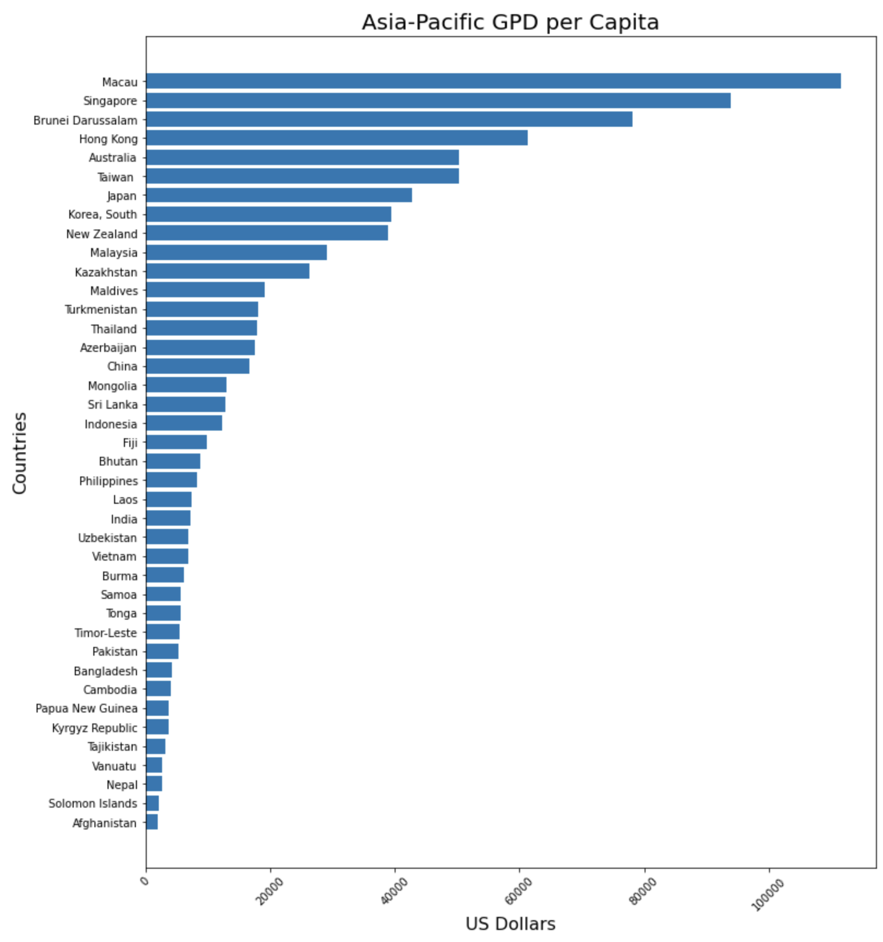
Asia Pacific

Slide 8
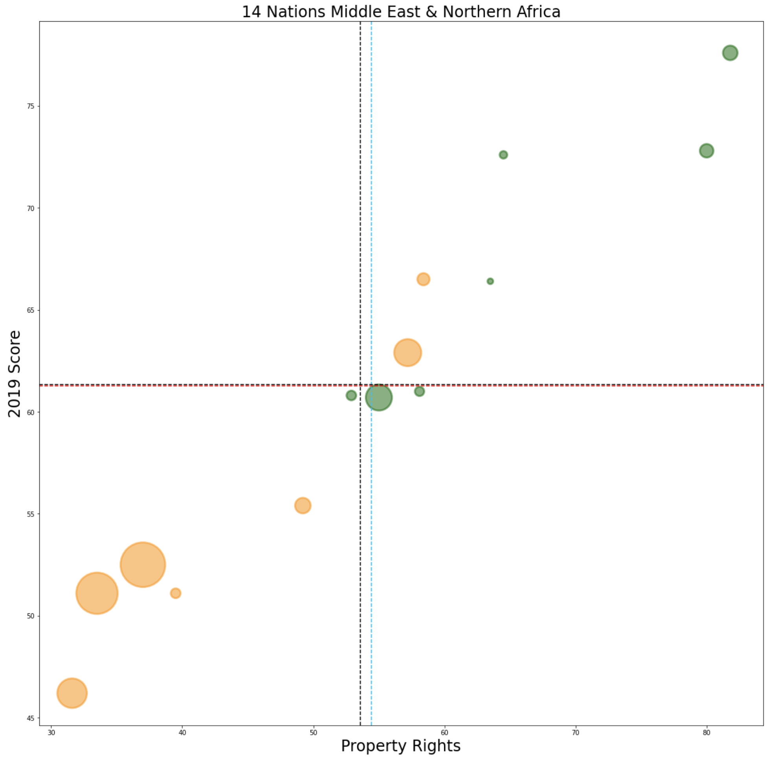
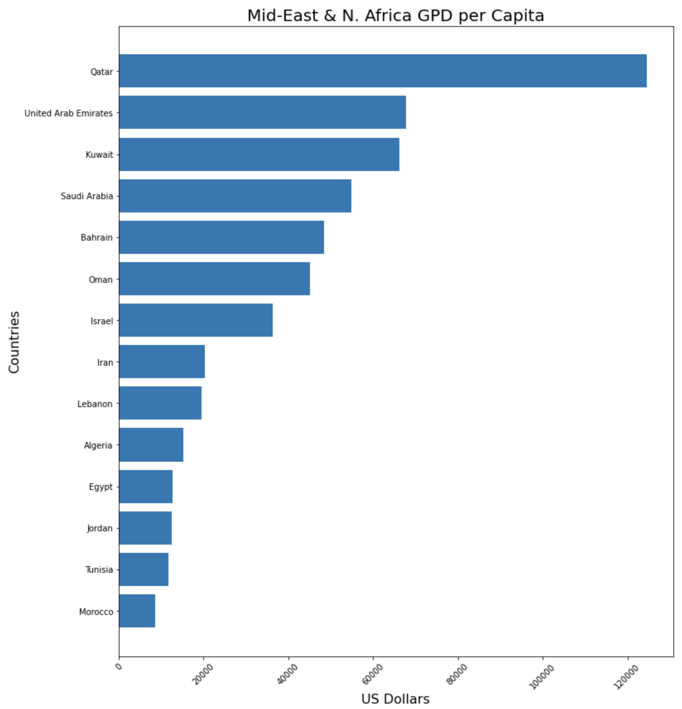
Middle East and Northern Africa

Slide 9
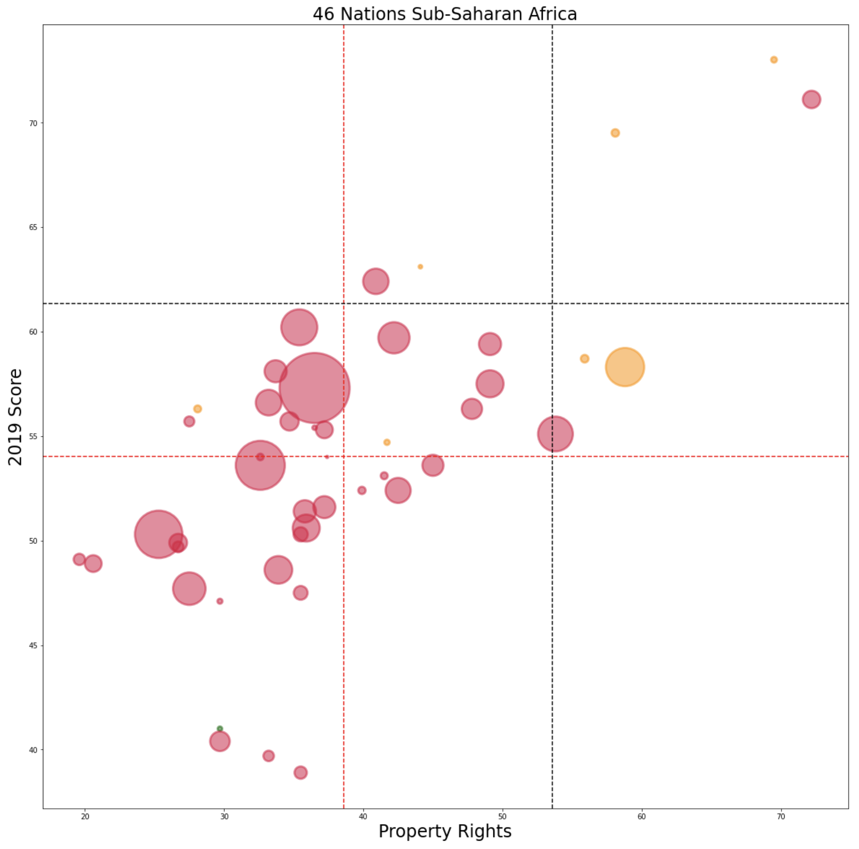
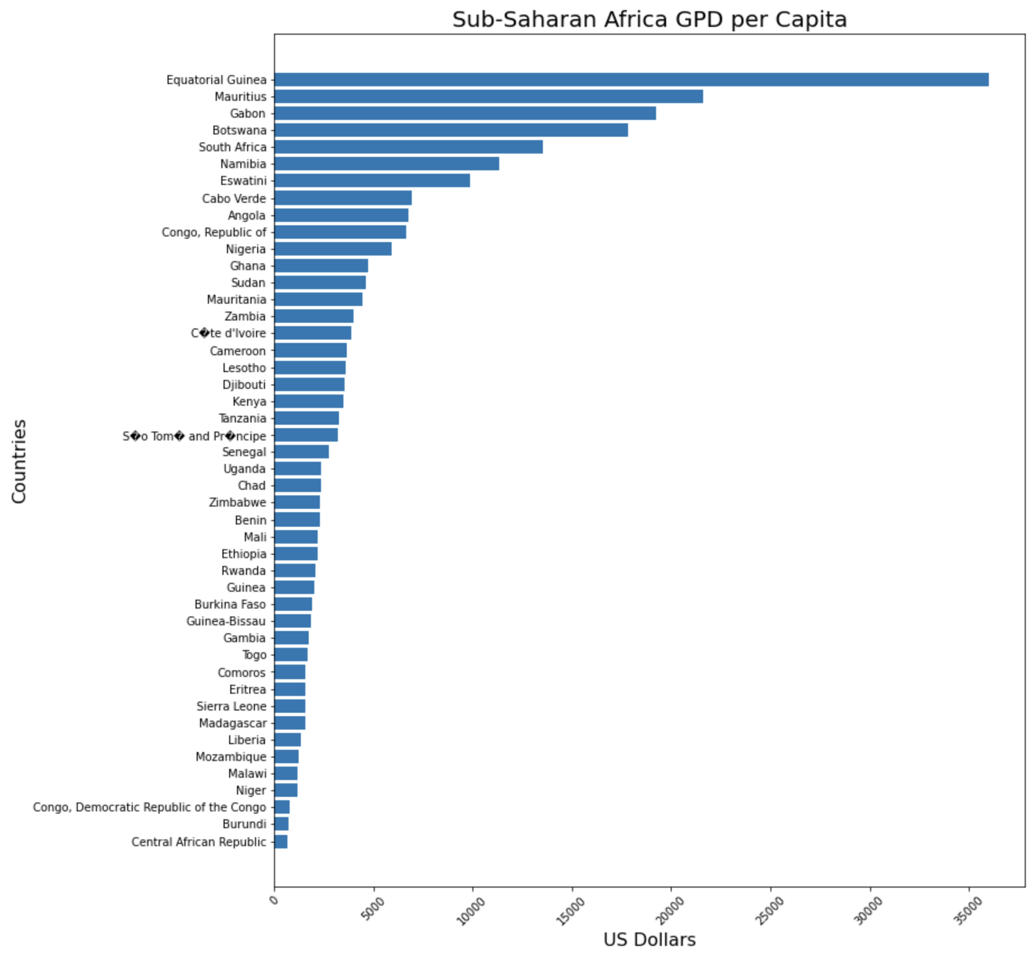
Sub-Saharan Africa Region

Slide 10
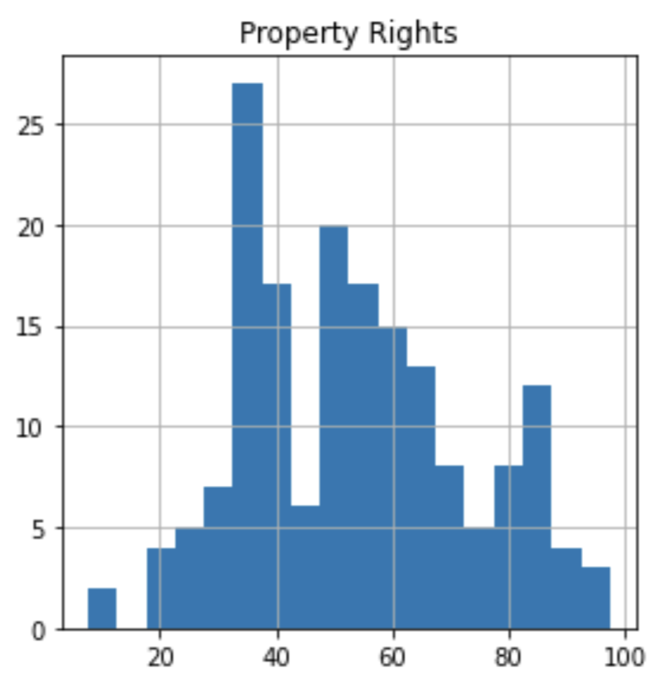
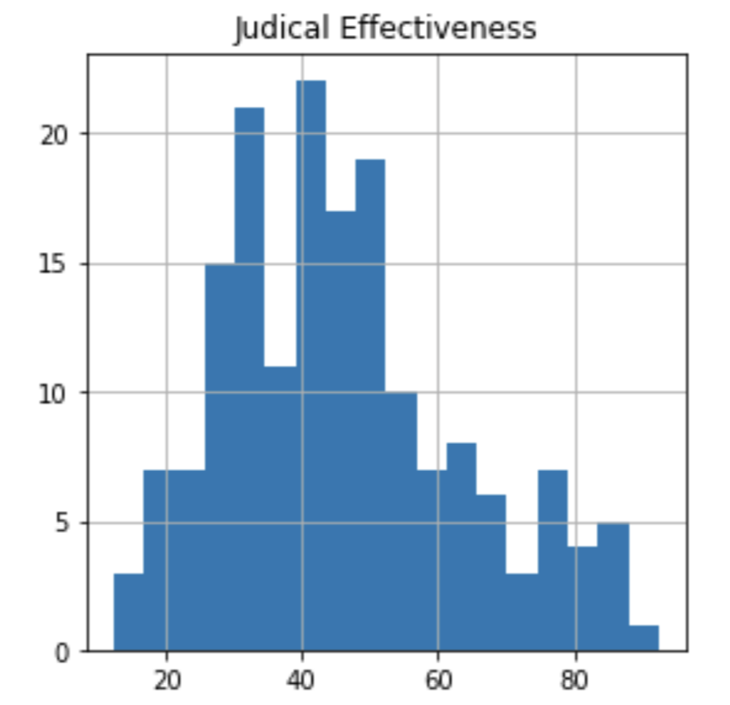
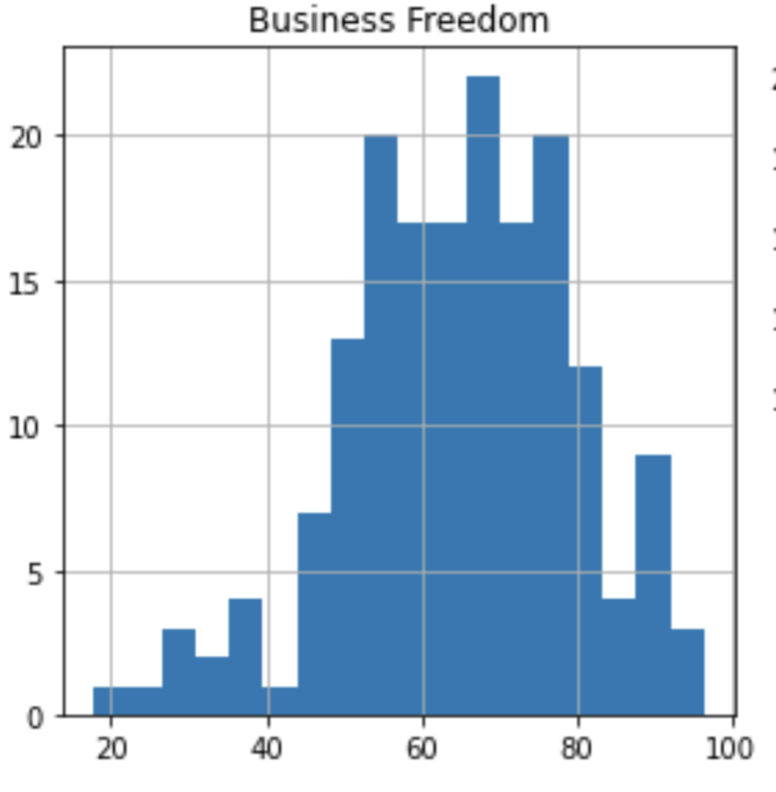
Statistical Test
Null Hypothesis:
America and Europe Property Rights Score are Equal.
Alt Hypo America and Europe Property Rights Scores are Different.
Americas Europe Ttest_indResult(statistic=-5.824, pvalue=< 0.001)

